Slide 1


Pedibus Development
Sponsored by Capital City Pedicab Company
In affiliation with the FSU and FAMU College of Engineering
Team 18:
Andrew Galan
John Hassler
James McCord
Onyewuchi Ebere
Sponsor: Instructor:
Ron Goldstein Dr. Kamal Amin
Faculty Advisors:
Dr. Chiang Shih
Dr. Patrick Hollis

Slide 2
Background
The pedibus is a pedal-powered vehicle used for transportation that seats a variety number of passengers depending on size.
The idea was developed to provide as an eco-friendly traveling entertainment center to attract people of all ages and professions.
        Some models contain alcohol distribution consoles in the center.
Also referred to as the pedal crawler, pubcrawler, and party bike.
The pedibus has grown in popularity over the last five years.
James McCord

Slide 3
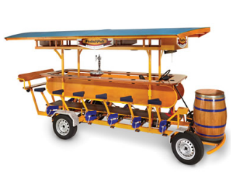
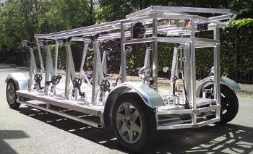
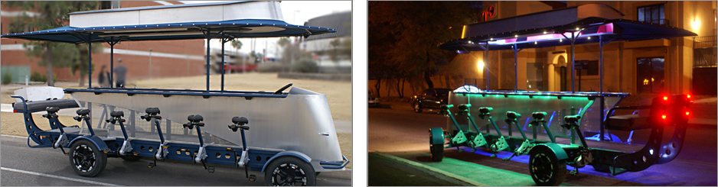
Existing Models
James McCord

Slide 4
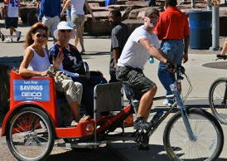
Sponsor
Ron Goldstein
Tallahassee Resident
Owner of Capitol City Pedicabs
Wants to manufacture the Pedibus for sale
James McCord

Slide 5
Final Design Selection
The Pedibus is broken down into three main components
        Structural frame
        Steering and braking
        Power transmission
James McCord

Slide 6
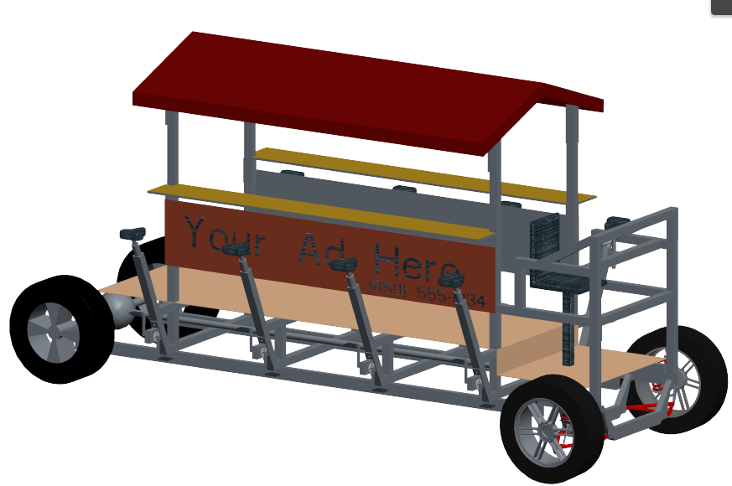
New Scope of Use
Sponsor has a potential investor who owns a local Ice-cream shop.
Wants the Pedibus to be suitable for children to ride
To accommodate this:
  The top will have adjustable heights for seats and table top
  Reassessed other components to attempt to cut total weight
  Frame analysis included 1000lb load on top platform to account for ice cream and cooler.
James McCord

Slide 7
Structural Frame
Requirements:
  Must be strong enough to support passengers weight
  Must be as light weight as possible
  Must be low cost
  Must be reliable with low maintenance
James McCord

Slide 8
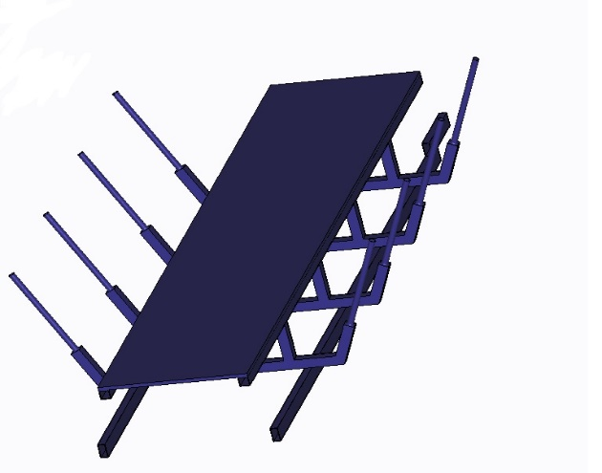
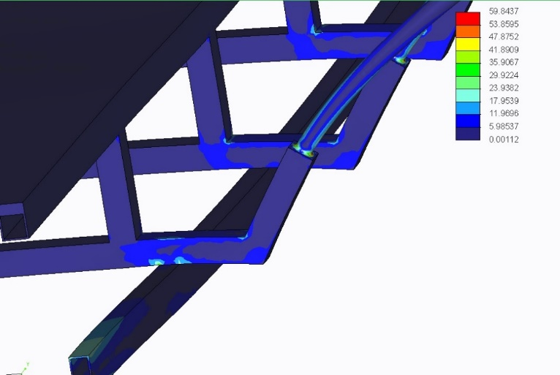
Aluminum or Steel
Initially we wanted to make a frame completely of Aluminum but after further analysis and modeling we concluded a mixture of the two would result in the most strength to weight ratio.
Using a minimalistic lower base of two steel rectangular beams to support the majority of the weight and an aluminum substructure above that.
James McCord

Slide 9
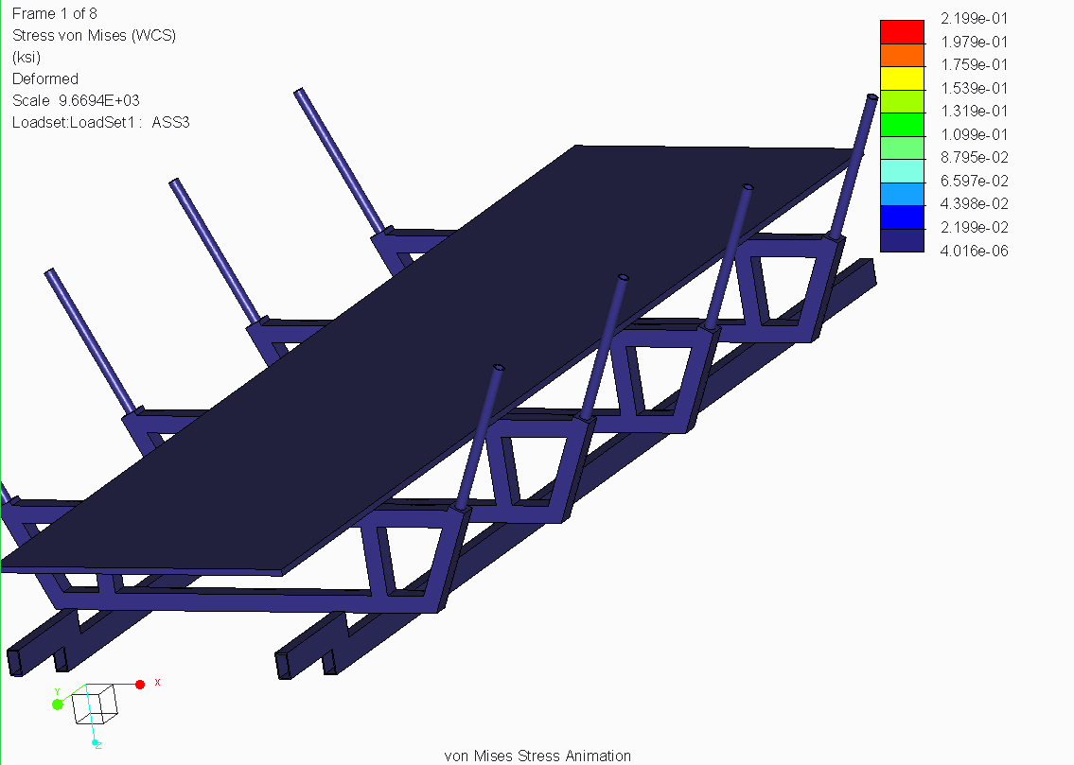
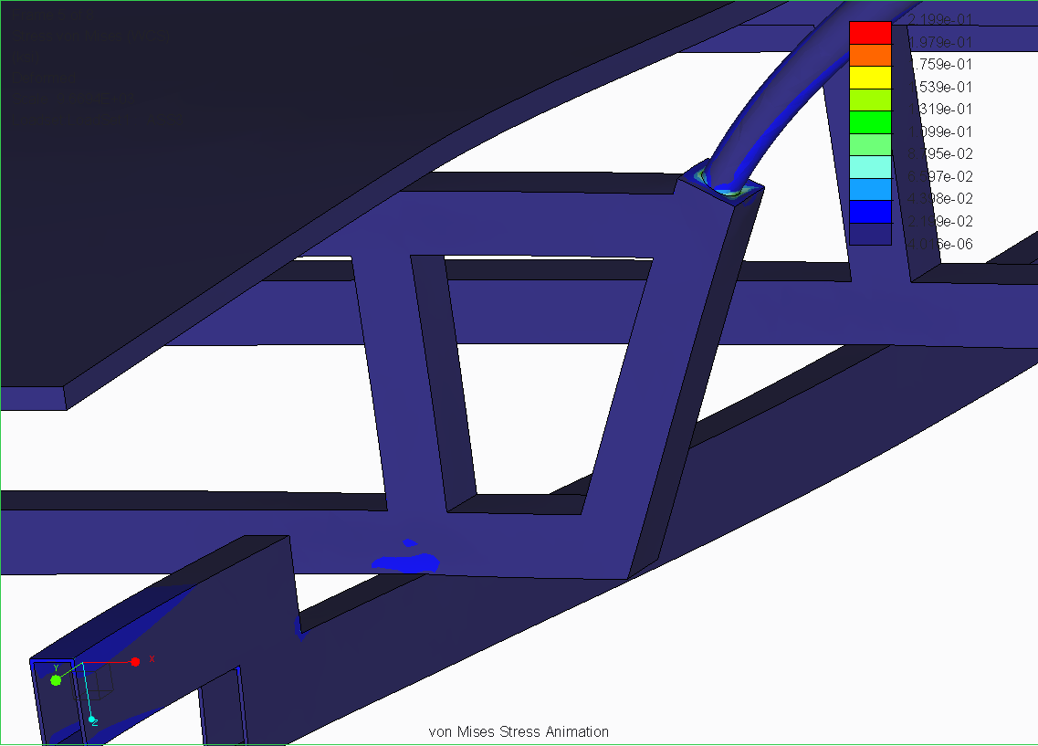
Improved Design
James McCord

Slide 10
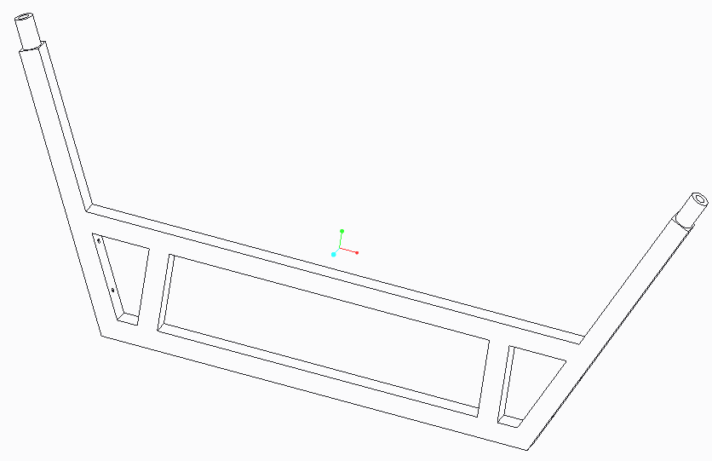
Final Crossmember Design
4th generation of the cross member

Slide 11
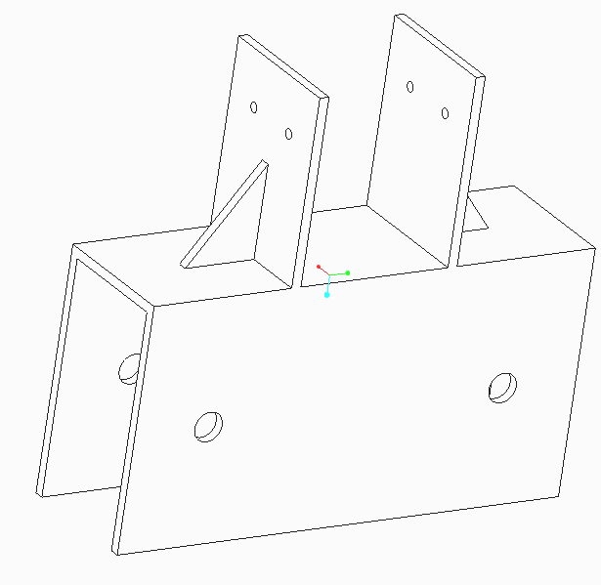
Angle brackets
Prevent deflection of the frame
Increase stability of the cross members
James McCord

Slide 12
Total Weight Reduction
Original plan with steel weighed over 1000lbs
New plan with aluminum weighs ~740 lbs
Cut over 250 lbs and 26% of the total weight of the vehicle
James McCord

Slide 13
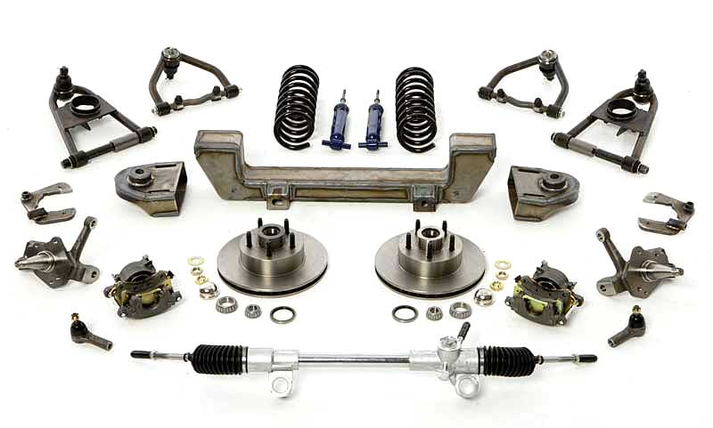
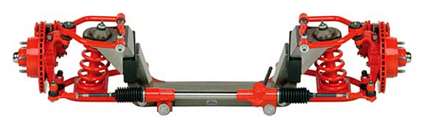
Front Axle
Decided on front end that included steering, braking, and suspension.
Chose Mustang II IFS for its light weight and simplicity
Andrew Galan

Slide 14
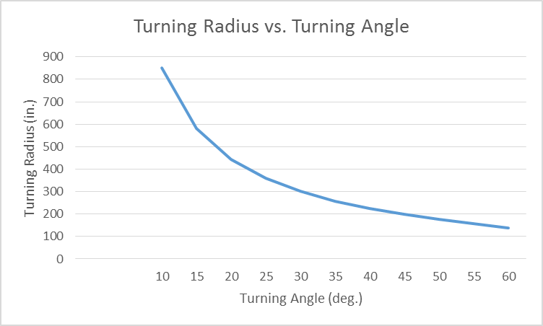
Steering Analysis
Rack-and-pinion steering for simplicity and reliability was chosen
The greater the turning radius, the smaller the turning angle.
Tight turning needed, since no reverse will be implemented.
Andrew Galan

Slide 15
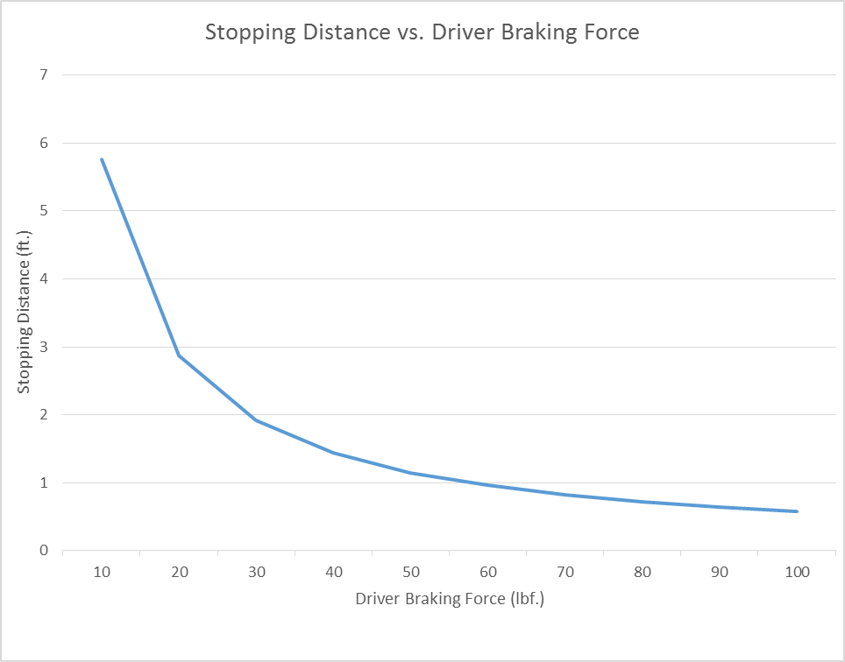
Braking Force
A hydraulic disc brake system was chosen
At 5 mph, the pedibus will stop within 1 foot if more than 50 lbf. is applied.
For smooth stop, apply brake pedal at low amounts of force.

Slide 16
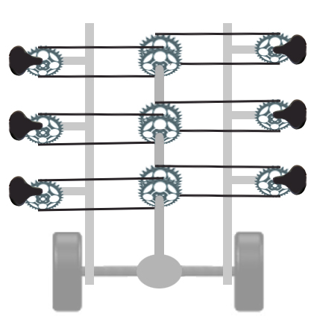
Drive Train Layout
Peddling input
Turns the drive shaft
Drive shaft turns rear differential
Differential turns the tires
John Hassler

Slide 17
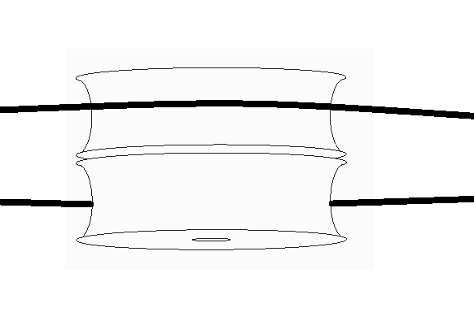
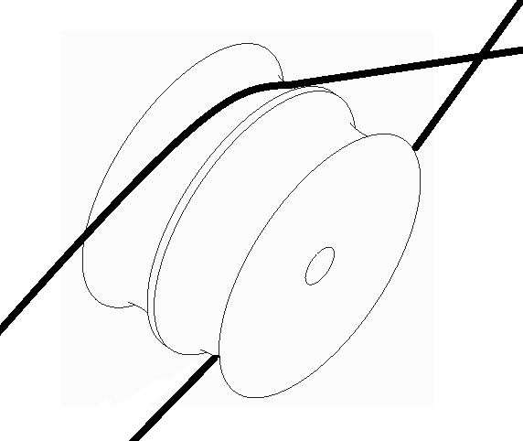
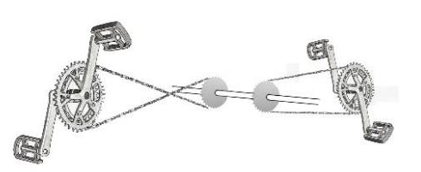
Drive Train Layout
Chains on one side crossed
Crossed chains run through pulley
Bike gears and chains installed to the right of cross member from passengers perspective
John Hassler

Slide 18
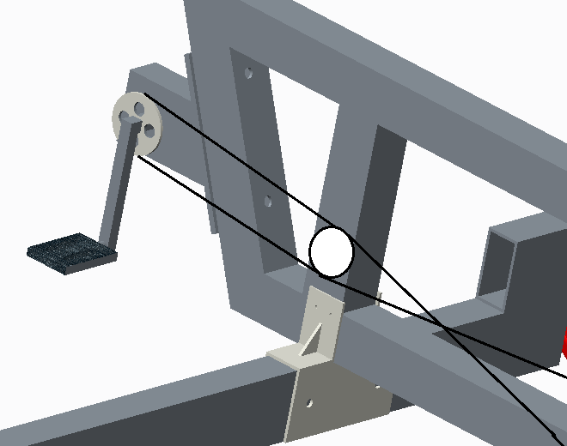
Drive Train Layout

Slide 19
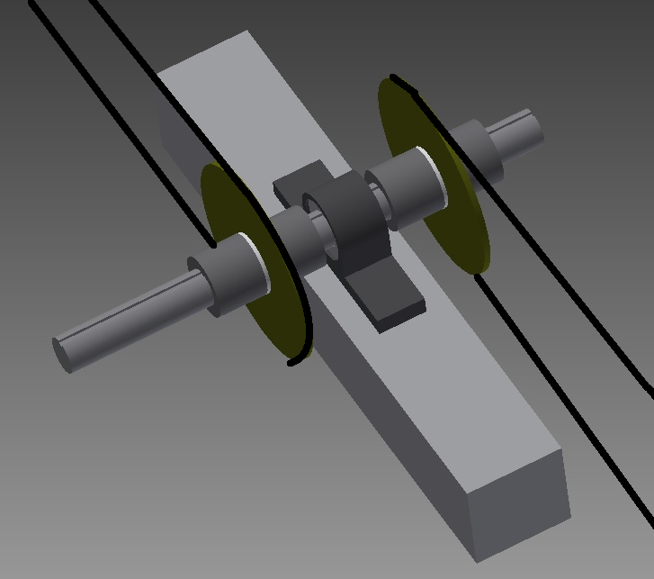
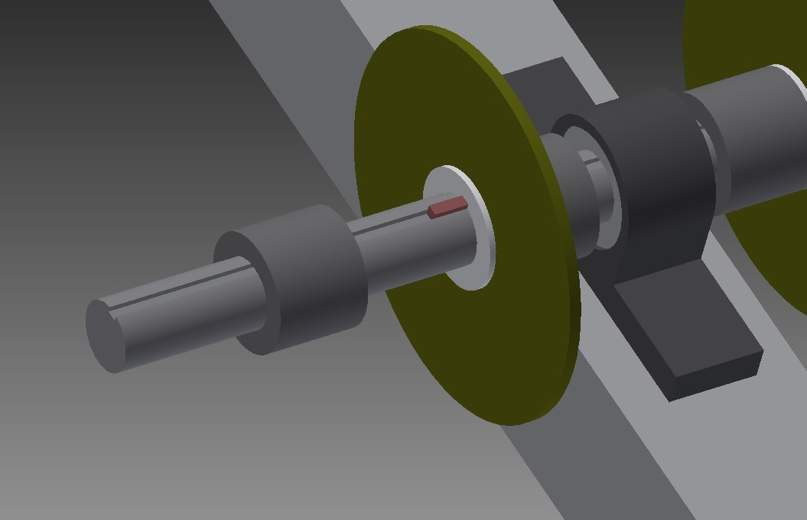
Drive Train Layout

Slide 20
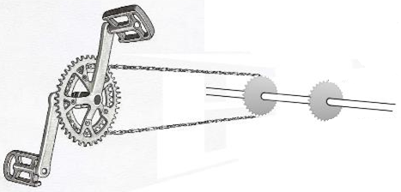
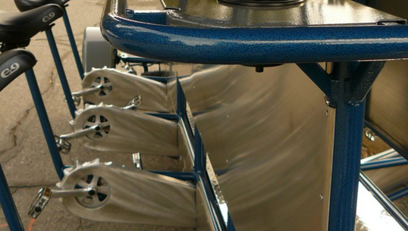
Drive Train Layout
Where to place the free wheel?
Free wheel at pedals
  Both gears and the chain turn whenever the vehicle is moving
  Better design for maintenance
  Sheet metal folded over the bike chain to improve safety
John Hassler

Slide 21
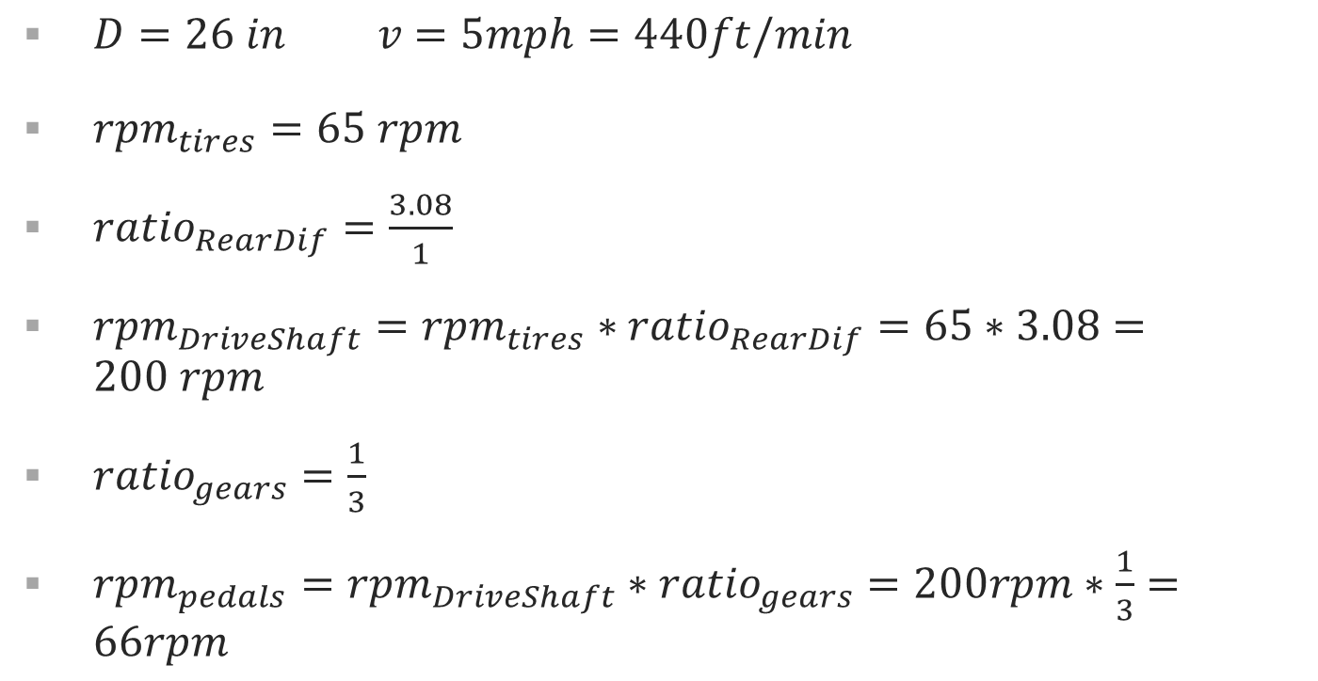
Gear Ratio Selection
$D=26 in v=5mph=440ft/min$
${rpm}_{tires}=65 rpm­$
${ratio}_{RearDif}=\frac{3.08}{1}$
${rpm}_{DriveShaft}={rpm}_{tires}∗{ratio}_{RearDif}=65∗3.08=200 rpm$
${ratio}_{gears}=\frac{1}{3}$
${rpm}_{pedals}={rpm}_{DriveShaft}∗{ratio}_{gears}=200rpm∗\frac{1}{3}=66rpm$
John Hassler

Slide 22
Sourcing Parts for Drive Train
Meeting with bike mechanic Thursday to source parts
Chose the rear axle from a Toyota t100 for its differential gear ratio of 3.08:1
Think we’ve found one locally that we are checking on later this week.
John Hassler

Slide 23

External Force Analysis
Drag Force on Pedibus
$F_{d}=\frac{1}{2}ρAC_{d}v^{2}$
$c_{d}=1.05$ (Drag coefficient for flat surface perpendicular to drag force)
$v=5mph$
$A=25{ft}^{2}$
$ρ=1.226\frac{kg}{m^{3}}$
$F_{d}=8N$
Onyewuchi Ebere

Slide 24
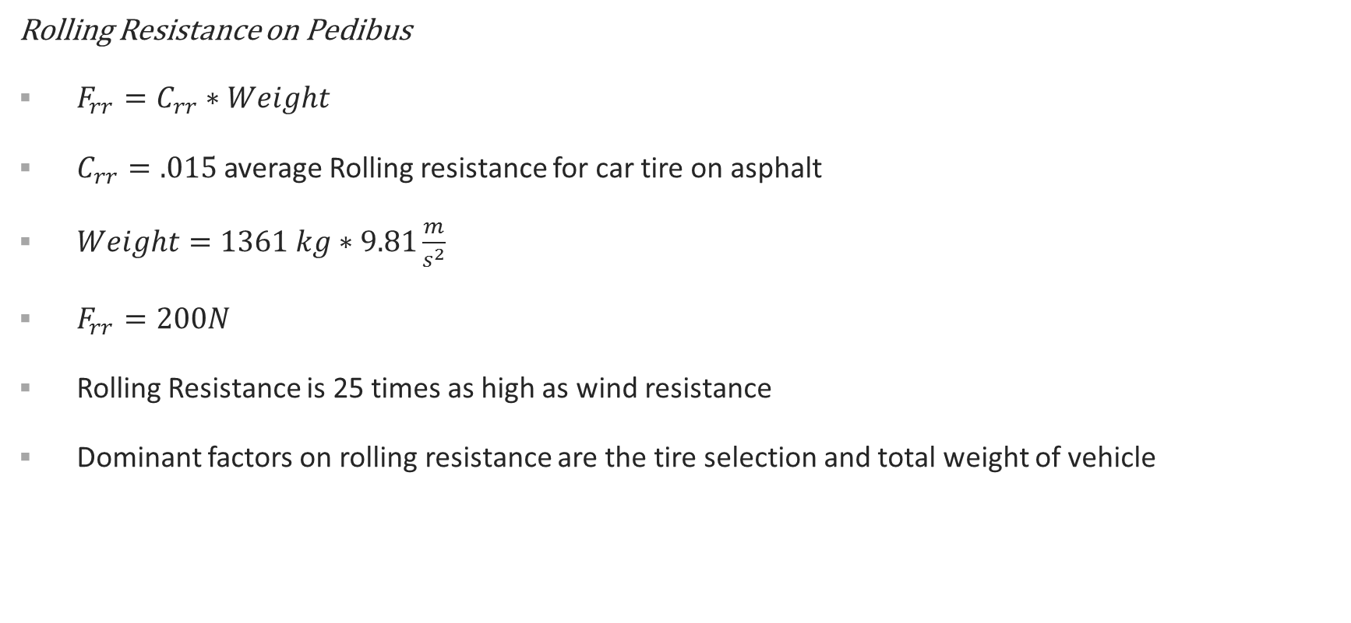
External Force Analysis
Rolling Resistance on Pedibus
$F_{rr}=C_{rr}∗Weight$
$C_{rr}=.015$ average Rolling resistance for car tire on asphalt
$Weight=1361 kg∗9.81\frac{m}{s^{2}}$
$F_{rr}=200N$
Rolling Resistance is 25 times as high as wind resistance
Dominant factors on rolling resistance are the tire selection and total weight of vehicle
Onyewuchi Ebere

Slide 25
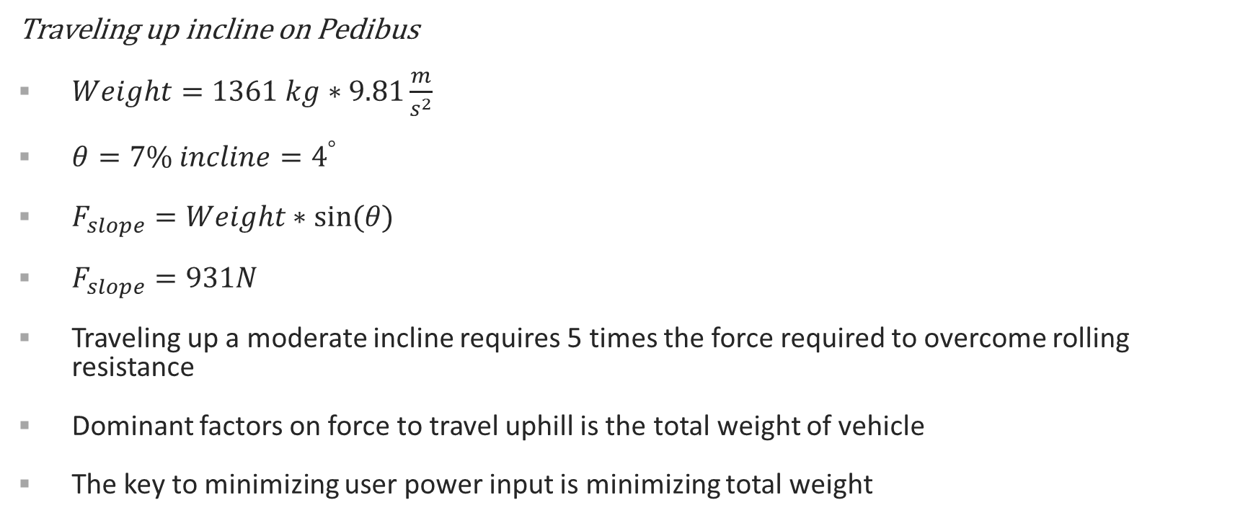
External Force Analysis
Traveling up incline on Pedibus
$Weight=1361 kg∗9.81\frac{m}{s^{2}}$
$θ=7\% incline=4^{°}$
$F_{slope}=Weight∗sin(θ)$
$F_{slope}=931N$
Traveling up a moderate incline requires 5 times the force required to overcome rolling resistance
Dominant factors on force to travel uphill is the total weight of vehicle
The key to minimizing user power input is minimizing total weight
Onyewuchi Ebere

Slide 26
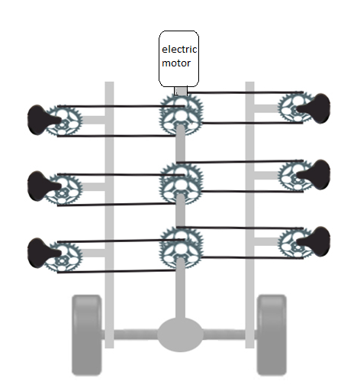
Power Improvements
Because rolling resistance is the major force we have to overcome we have picked a tire with the lowest rolling resistance.
For traveling up inclines or operating at less than full capacity or with children the vehicle should have a power assist electric motor
With electric motor we have the option for reversing the vehicle
Onyewuchi Ebere

Slide 27
Passenger Power Input Analysis
How hard do passengers have to pedal to accelerate the pedibus from rest?
How hard do passengers have to pedal to maintain a cruising speed of 5 mph?
ACTIVITY | POWER OUTPUT (Watts)
Walking | 30W
Average person biking | 120W
Regular cyclist | 220W
Proffesional athlete | 300W
Lance Armstrong | 400W
John Hassler

Slide 28
Passenger Power Input Analysis-Maintaining Speed
Power (watts) | # of Passengers
222 | 1
131 | 2
101 | 3
85 | 4
76 | 5
70 | 6
66 | 7
63 | 8
John Hassler

Slide 29
Passenger Power Input Analysis-Accelerating
Power Watts | # of Passengers
346 | 1
205 | 2
159 | 3
135 | 4
121 | 5
112 | 6
105 | 7
100 | 8
John Hassler

Slide 30
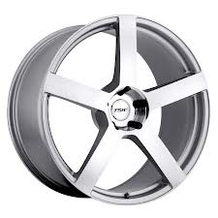
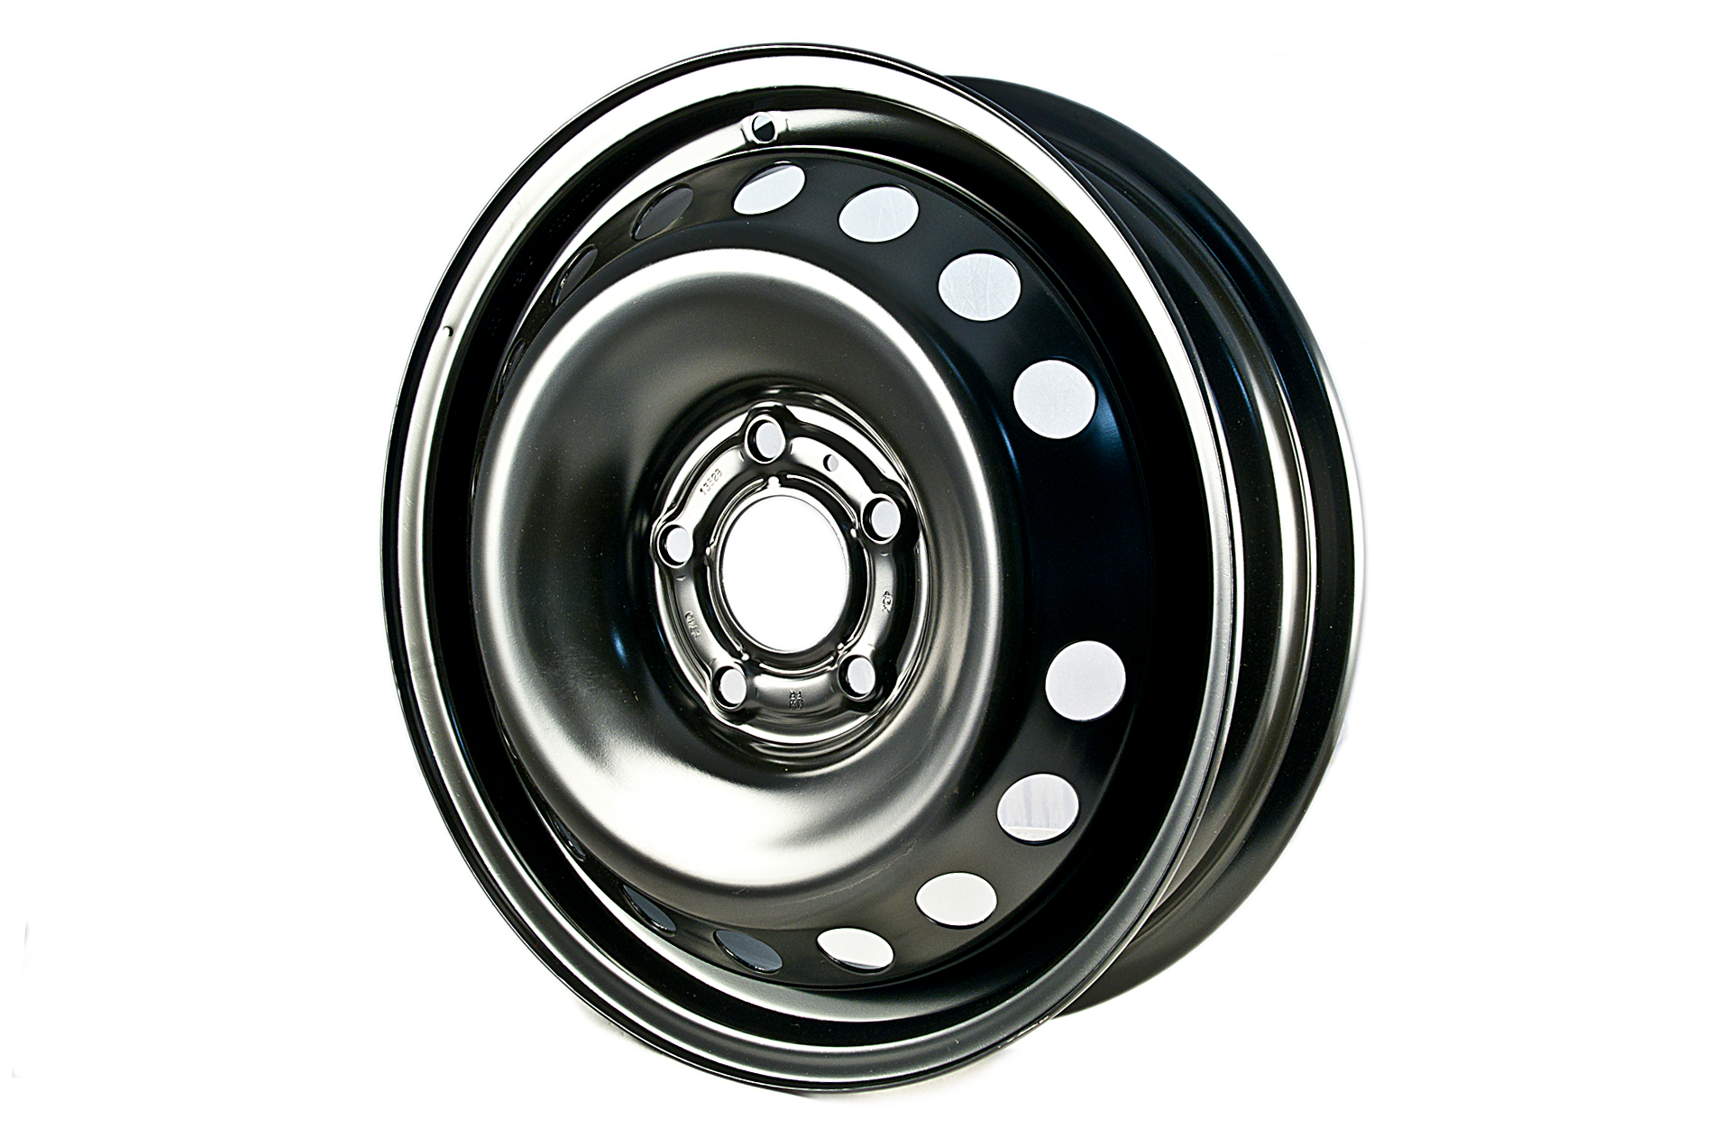
TIRE AND RIM SELECTION
29
After critically analyzing the complete system the final choice on tire and rim was made.
Rim specification
Non alloyed rim
Alloyed rim
Onyewuchi Ebere

Slide 31
30
TIRE AND RIM SELECTION
Rim size 16in:
Here are the reasons for the size choice.
It fits in the tire with the least rolling force.
It has exact number of stud holes and fits perfectly to the hub.
It gives the pedibus a better base clearance height.
Rim material: aluminum alloyed wheel.
To achieve our goal in terms of least overall weight, strength,
and gaining people’s attention.
We choose a rim that combines the properties we need in terms of
light weight.
Strong
Durable
Readily available.
High finishing and fancy rim (aluminum alloyed rim)
Which can only be obtained in any of the rims we have selected.
Onyewuchi Ebere

Slide 32
TIRE SELECTION
31
The tire we selected is P255/60R16 and the reason for its selection includes.
It has the lowest coefficient of rolling resistance 0.00650.
Cheap and readily available.
It has greater pneumatic shock absorption property.
Onyewuchi Ebere

Slide 33
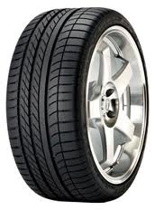
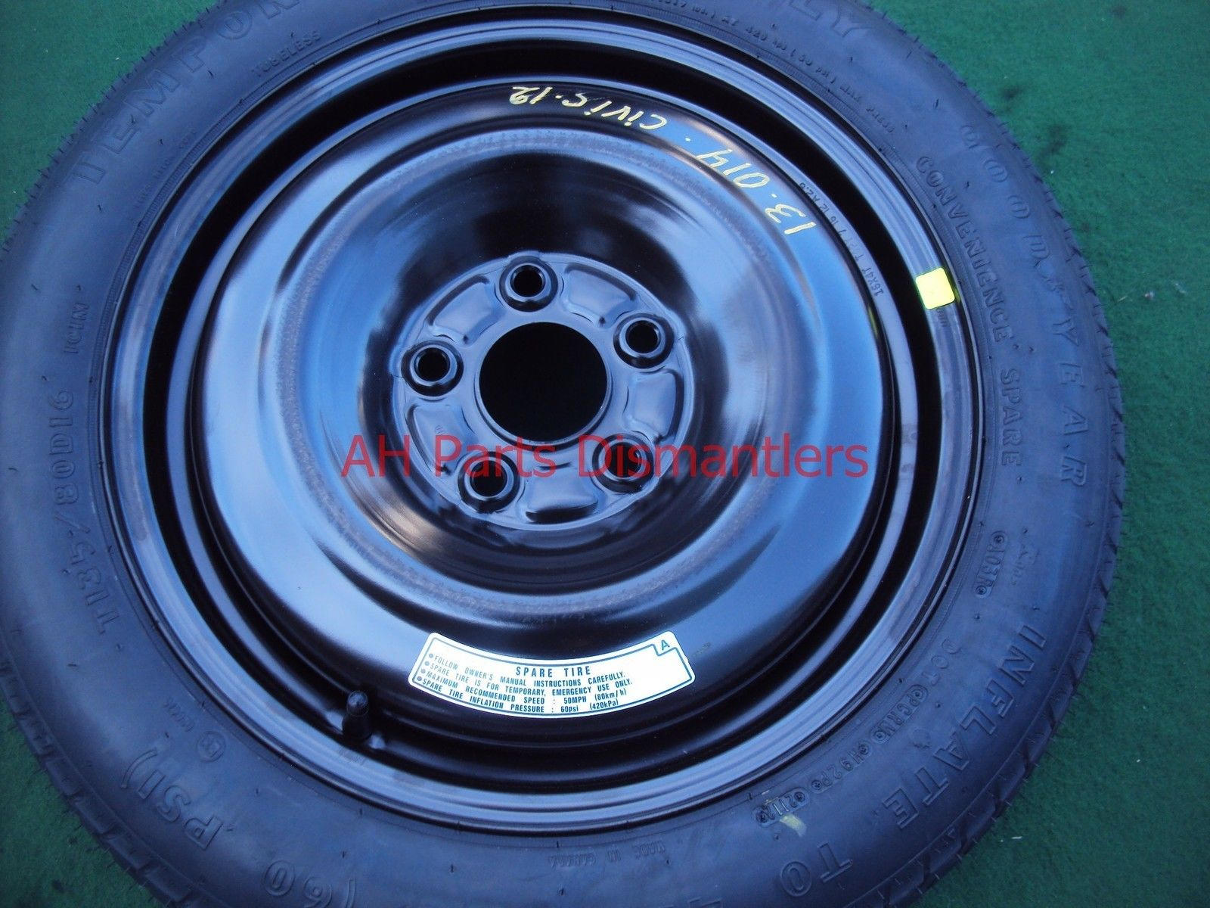
P255/60R16
32
Cheap but not stylish($104 x4)
Expensive but stylish($250x4)
Onyewuchi Ebere

Slide 34
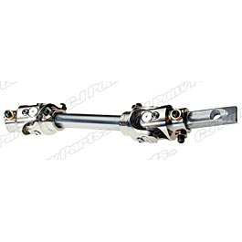
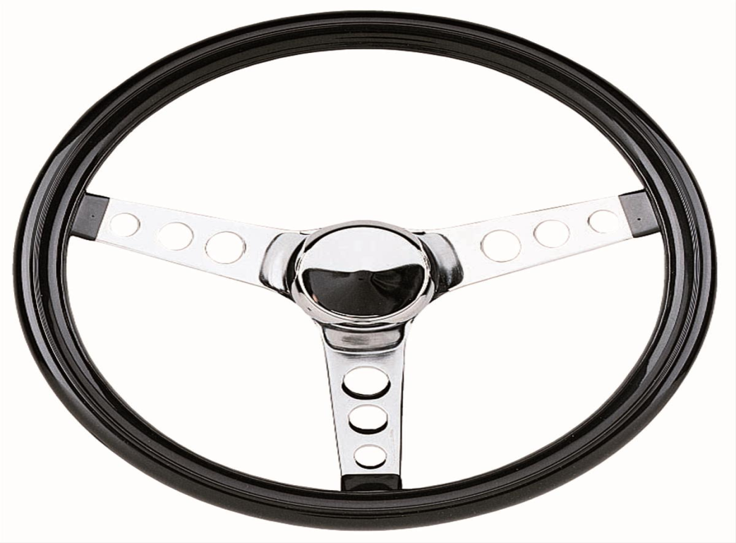
Steering column and steering wheel
33
We selected a flexible type of steering column with two universal joints
Which will enhance easy relocation of the drivers seat, adjustment and improve driver’s ergonomics.
This steering wheel has proved lightest in weight and strongest among all the steering wheels considered.
Onyewuchi Ebere

Slide 35
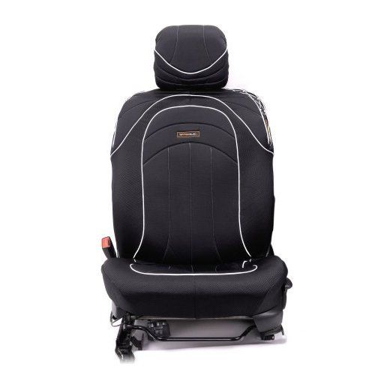
Driver Seat Selection
34
it will improve drivers comfort.
It provide for the installation of drivers seat belt for safety of the driver.
Readily Available and cheap compared to fabricating new one.
It has provision for sliding the seat forward or backward depending on the drive’s choice.
Kia picante driver’s seat($120)
Onyewuchi Ebere

Slide 36
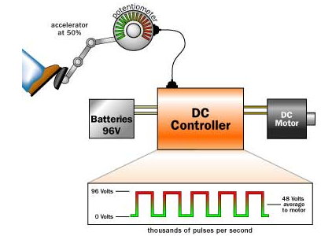
Power Assistance
Allows pedibus to be driven up an inclination
Electric DC motor will be used convert electrical energy into mechanical energy
Required at 5 mph:
    168 RPM
    145 N-m (Torque)
    ≈ 3.4 HP
Motor Selection based on calculated assumptions.
    D&D 170-004-0001 Motor
          36 Volt
          Increase in torque
          12 mph approximate speed
    Alltrax AXE 4844 400 amp Controller with fuse
Andrew Galan

Slide 37
Ergonomics & Safety
Will have head lights, break lights, turn signals.
Folded sheet metal over the moving bike parts
Handles in the bar top
Parking break on drive shaft
Slow traveling speed as safe as we can make it
Driver has a seatbelt
In short if you wouldn’t feel safe riding a bike don’t ride the pedibus
Andrew Galan

Slide 38
Budget
BOM |  | # | Price Per Item
Steel Supports |  | 2 | $69.00 | $138.00
Aluminum Frame |  | 1 | $389.00 | $389.00
Pillow Blocks |  | 4 | $30.00 | $120.00
3/4 inch Cold Rolled Drive Shaft |  | 1 | $100.00 | $100.00
Mustang II Ifs |  | 1 | $1,100.00 | $1,100.00
Rear Axle and Differential |  | 1 | $300.00 | $300.00
Bike Crank |  | 8 | $45.00 | $360.00
Bike Seat |  | 8 | $17.00 | $136.00
Bike Chain |  | 8 | $30.00 | $240.00
Free Wheel gear |  | 8 | $25.00 | $200.00
Wheels |  | 4 | $104.00 | $416.00
Electric Motor & Controller |  | 1 | $880.00 | $880.00
Battery |  | 1 | $53.00 | $53.00
Lighting Kit |  | 1 | $170.00 | $170.00
total |  |  |  | $4,602.00
Andrew Galan

Slide 39
Future Plans
Order raw material and parts for construction of Pedibus
Meet with bike mechanic to source bicycle components
Find outside resources to help with assembly
Run performance test on assembled vehicle
Keep in close contact with sponsor, advisors, and bicycle mechanic
Andrew Galan

